Slide 1

Chapter 2
Understanding the SEMMA Methodology in Modern Data Mining
Teh Ying Wah tehyw@um.edu.my University of Malaya

Slide 2
Course Outline
Introduction to the SEMMA Methodology
Sampling Techniques in Data Mining
Exploration in Data Mining
Modification in Data Mining
Modelling in Data Mining
Assessment in Data Mining
Importance of SEMMA in Data Mining
Conclusion

Slide 3
Learning Objectives
By the end of this chapter, students should be able to:
Apply each step of the SEMMA methodology to mine datasets effectively.
Employ appropriate sampling techniques, such as random and stratified random sampling, to select representative subsets of data.
Appreciate the importance of the SEMMA methodology in deriving valuable insights from data mining.
Utilize data visualization techniques for exploring data, including univariate, bivariate, and trivariate visualizations.

Slide 4
Introduction to the SEMMA Methodology
The SEMMA methodology is a structured approach to data mining, developed by the SAS Institute. SEMMA stands for Sample, Explore, Modify, Model, and Assess, representing the sequential steps involved in the data mining process.
This methodology is designed to extract valuable information and insights from large datasets, enabling organizations to make informed decisions.
while SEMMA is foundational, it has evolved with new data science tools, cloud computing, and big data technologies.

Slide 5
1. Modern Sampling Techniques in Big Data Environments
Objective: Select a representative subset of data from the entire dataset.
Importance: Sampling helps in reducing the volume of data, making it manageable and efficient to analyze, without losing the essential characteristics of the original dataset.
Techniques: Random Sampling, Stratified Sampling, Systematic Sampling, Distributed Sampling, Real-Time Sampling

Slide 6
1.1 Random Sampling
Random sampling is a fundamental technique used in both statistics and data analysis, including data mining, to select a subset of individuals or observations from a larger population or dataset.
The key characteristic of random sampling is that every individual or observation in the population has an equal chance of being included in the sample.

Slide 7
Objectives of Random Sampling:
Representativeness: To obtain a sample that accurately reflects the characteristics of the entire population.
Reduction of Bias: To minimize the risk of selecting a non-representative sample that could lead to skewed or biased results.
Feasibility: To make the analysis more manageable and efficient by reducing the volume of data to be analysed.

Slide 8
Example of the process of random sampling
Hypothetical Scenario:
Objective: Conduct a survey on study habits among university students.
Population: 1000 students in a university.
Step 1: Define the Population
The population is defined as all the students in the university, totalling 1000 students.
Step 2: Determine the Sample Size
Suppose we decide to sample 100 students (10% of the population) for the survey.
Step 3: Assign Identifiers
Each student in the population is assigned a unique identifier, a number between 1 and 1000.

Slide 9
example of the process of random sampling
Step 4: Use a Random Mechanism
Utilize a random number generator or draw lots to select 100 unique numbers between 1 and 1000.
For example, you can use a computer-based random number generator or a random number table to generate 100 random numbers between 1 and 1000.
Step 5: Collect the Sample
The students corresponding to the 100 selected numbers are included in the sample.
These selected students are then approached to participate in the survey.
Result:
You now have a random sample of 100 students from the university to participate in your study-on-study habits.
Notes:
This is a simple random sampling example where each student had an equal chance of being selected.
Ensure that the selected random numbers are unique to avoid sampling the same individual more than once.
The sample obtained through this method is assumed to be representative of the entire population, allowing for generalization of the survey results to all students in the university, with a calculable margin of error.
This process ensures that every student has an equal opportunity to be included in the sample, reducing selection bias and allowing for the generalization of the survey results to the entire student population of the university.

Slide 10
1.2 Stratified random sampling
Stratified random sampling is a type of sampling method in which the total population is divided into distinct subgroups or strata that share similar characteristics.
Random samples are then drawn from each stratum. This method aims to ensure that every subgroup of the population is adequately represented in the final sample, providing more precise and reliable results compared to simple random sampling, especially when there is significant variability within the population.

Slide 11
Example of Stratified random sampling
Suppose a researcher wants to study the study habits of university students and knows that the university has significant variability in ungraduated level (1st to 4th year).
The researcher could use stratified random sampling, treating each level as a stratum, and then randomly selecting students from each level.

Slide 12
Distributed Sampling
Distributed sampling in tools like Hadoop, Apache Spark, and Google BigQuery is essential for working with large-scale datasets that are too big to fit into the memory of a single machine. These tools employ distributed computing to split data across multiple nodes (servers) in a cluster, allowing for faster and more efficient sampling.
Hadoop is based on the MapReduce programming model, which is designed for distributed processing of large datasets.

Slide 13
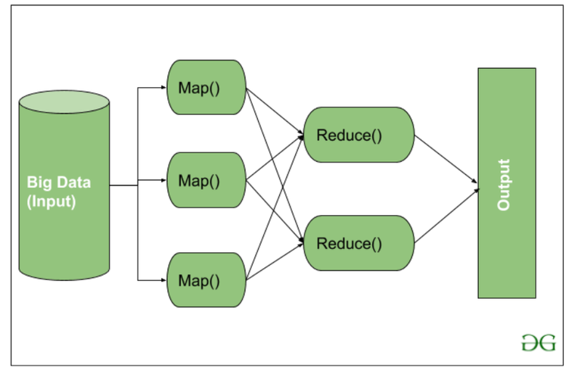
Distributed Sampling in Hadoop - How It Works:
Data Splitting (Map Phase): Hadoop breaks large datasets into smaller chunks, called splits. Each split is processed by a separate node in the Hadoop cluster.
MapReduce Sampling: A sampling function can be applied during the Map phase to each chunk independently. Hadoop reads a subset of data from each split, based on the sampling rate (e.g., 10% of the data from each split).
Combine and Reduce: After the Map phase, the Reduce phase aggregates the sampled data from each node to form the final sample.
[1]

Slide 14
Distributed Sampling in Hadoop - Advantages:
Handles massive datasets across distributed nodes.
Can process large datasets in parallel.
Highly scalable for big data environments.

Slide 15
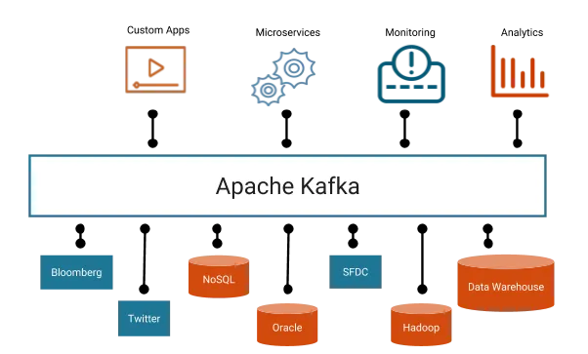
Real-Time Data Streams and Continuous Sampling Using Technologies like Apache Kafka
Real-time data streams are continuously flowing datasets that are generated from various sources, such as sensors, applications, logs, or user interactions.
Technologies like Apache Kafka are designed to manage and process these streams efficiently, enabling continuous sampling and analysis without the need for storing all data upfront.
[2]

Slide 16
How Apache Kafka Works for Real-Time Streaming
Apache Kafka is an open-source distributed event streaming platform designed for high-throughput, fault-tolerant, real-time data pipelines and streaming applications.
Core Concepts in Kafka:
Producers: Applications that send data (events) to Kafka.
Topics: Kafka organizes events into categories called topics. Each topic represents a stream of related data (e.g., user activity or sensor readings).
Partitions: Kafka topics are split into multiple partitions to allow for scalability. Each partition is processed by a separate consumer.
Consumers: Applications or services that subscribe to topics and consume data in real-time.
Brokers: Kafka servers that handle the storage, distribution, and retrieval of events.
Kafka enables real-time processing by continuously ingesting data, storing it in partitions, and allowing multiple consumers to process this data in real-time.

Slide 17
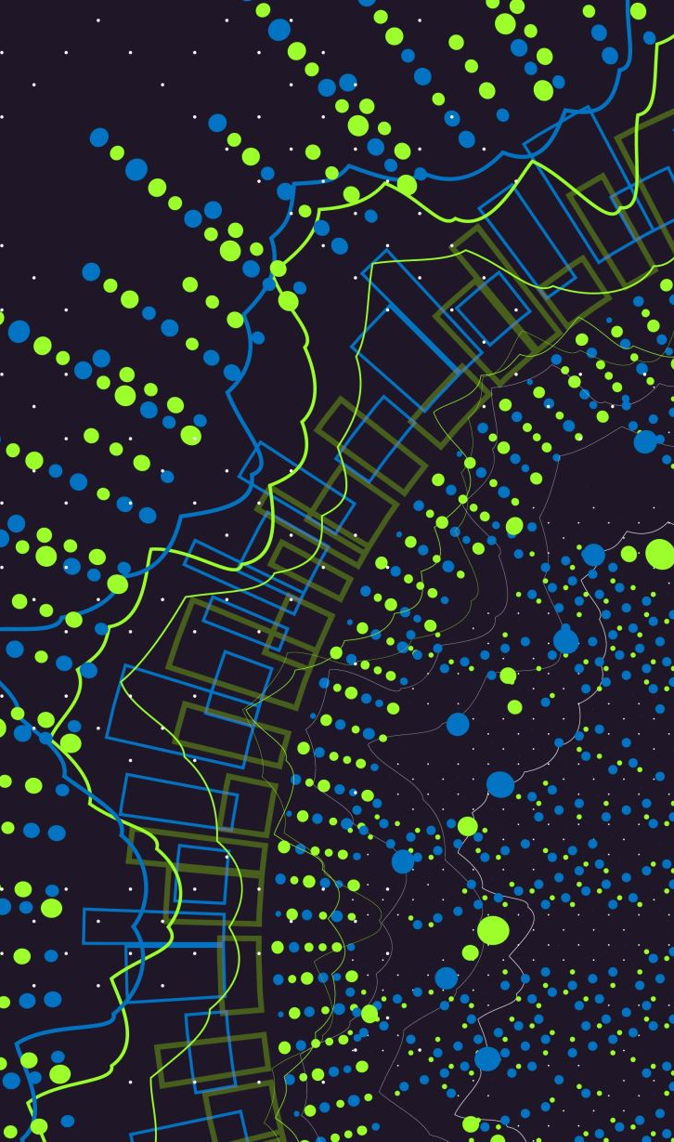
2. Data Exploration with Modern Visualization and EDA Tools
Objective: Investigate the sampled data to identify patterns, relationships, anomalies, and trends.
Importance: Exploration provides a deeper understanding of the data, helping to uncover underlying structures and characteristics.
Techniques: Descriptive Statistics, Data Visualization, Correlation Analysis.

Slide 18
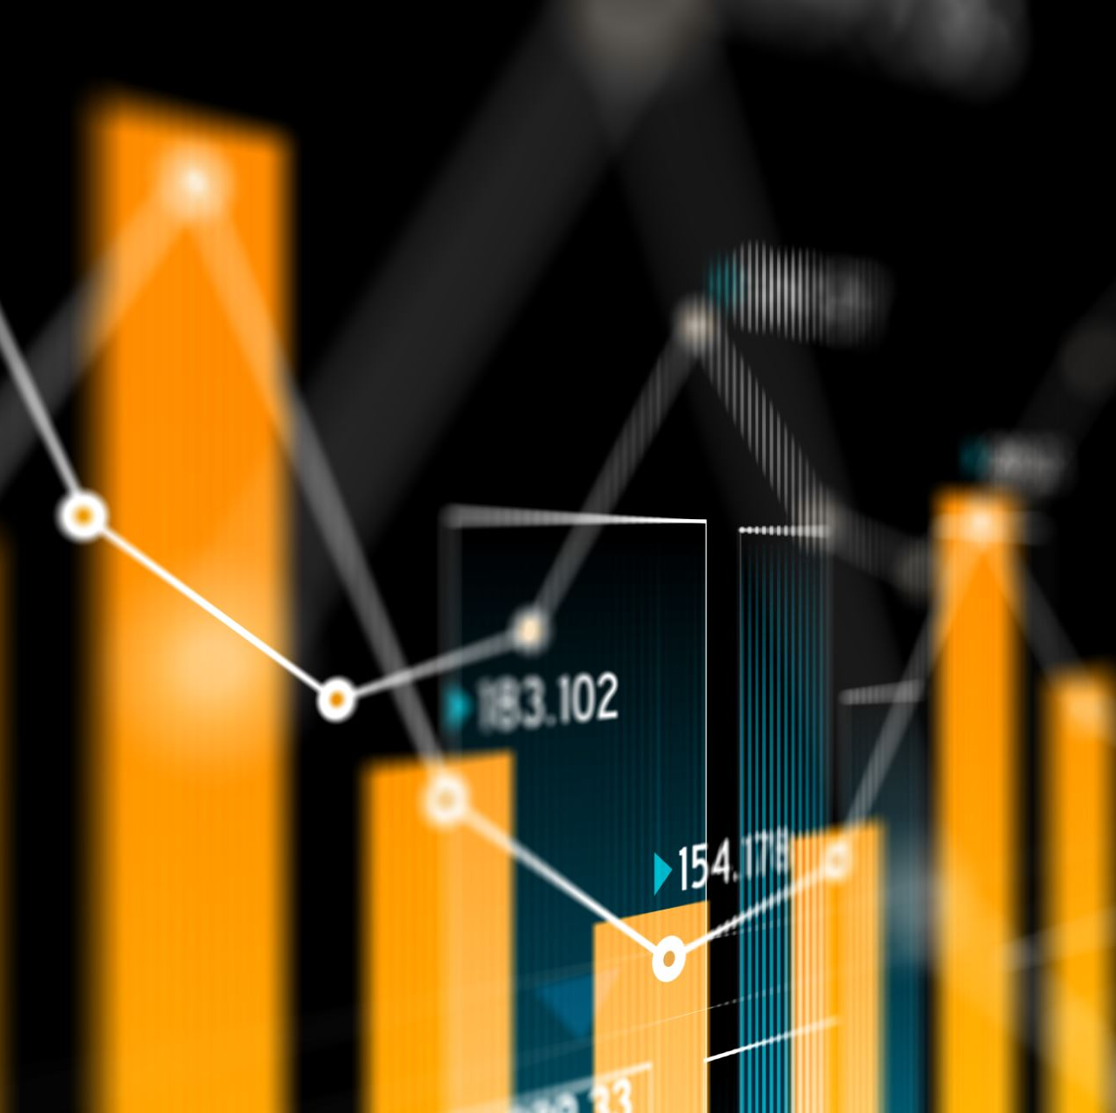
Data visualization
Data visualization is a crucial component in data analysis and exploration, allowing for the graphical representation of information and data. It can indeed be used to represent one, two, or three variables, among others, each serving different purposes and providing different insights.

Slide 19
2.1 One-Variable Visualization (Univariate)
Objective: To understand the distribution, central tendency, and spread of a single variable.
Visualizations:
Histogram: Shows the frequency distribution of a continuous variable.
Bar Chart: Represents the frequency or proportion of categories in a categorical variable.
Box Plot: Provides a summary of the central tendency and spread of a continuous variable.
Pie Chart: Depicts the proportion of different categories in a categorical variable.
Example: A histogram showing the distribution of ages in a dataset.

Slide 20
2.2 Two-Variable Visualization (Bivariate)
Objective: To explore the relationship, correlation, or interaction between two variables.
Visualizations:
Scatter Plot: Illustrates the relationship between two continuous variables.
Stacked Bar Chart: Represents the relationship between one categorical and one continuous variable or two categorical variables.
Line Graph: Depicts the trend or relationship between two continuous variables, typically with one being time.
Box Plot: Can also be used to compare the distribution of a continuous variable across different categories of a categorical variable.
Example: A scatter plot showing the relationship between height and weight in a dataset.

Slide 21
2.3 Three-Variable Visualization (Trivariate)
Objective: To understand the interactions or relationships among three variables simultaneously.
Visualizations:
3D Scatter Plot: Represents the relationship among three continuous variables.
Bubble Chart: A scatter plot where the size of the bubble represents the third variable.
Grouped Bar Chart: Represents the relationship among two categorical variables and one continuous variable.
Stacked Area Chart: Depicts the relationship among one continuous and two categorical variables or three continuous variables, typically with one being time.
Example: A bubble chart where the x-axis represents age, the y-axis represents income, and the size of the bubble represents spending.

Slide 22

Modern Exploratory Data Analysis (EDA) Tools
Modern EDA tools have evolved to support the growing complexity of data and user needs, offering a variety of functionalities from automation, interactivity, and scalability to seamless integration with databases and cloud systems.
For automation and quick reports: Pandas Profiling, Sweetviz, and Dataprep are great choices.
For interactive exploration: D-Tale, Lux, and Plotly Express offer more hands-on, interactive ways to explore data.
For business intelligence: Tableau, Power BI, and Apache Superset excel in creating dashboards for large-scale business data.
Choosing the right tool depends on your specific needs, whether you're working with small datasets in Python or need to create real-time interactive dashboards for an enterprise.

Slide 23
3. Data Preprocessing with Advanced Pipelines and Automation
Objective: Preprocess and transform the data to prepare it for modelling.
Importance: Modification ensures that the data is clean, relevant, and properly formatted, improving the accuracy and effectiveness of the subsequent modelling step.
Techniques: Data Cleaning, Feature Engineering, Data Scaling and Normalization.

Slide 24
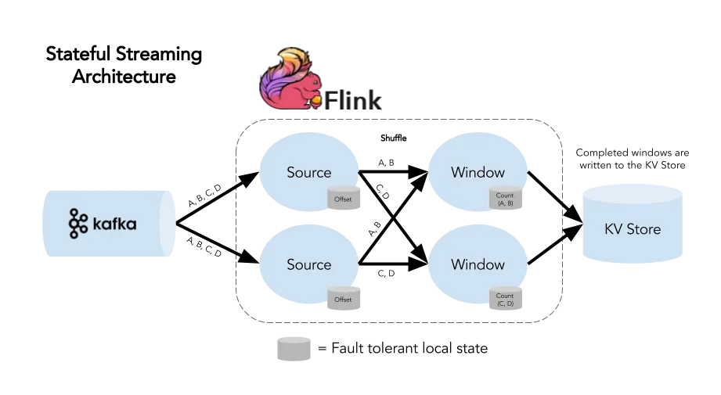
Data Preprocessing with Advanced Pipelines and Automation - Tools
Data Cleaning Automation: tool like Great Expectations for data validation and cleaning.
Feature Engineering: Automated feature engineering using Featuretools or AI-driven techniques like AutoML.
Big Data Processing: Tools like Apache Flink, Databricks, and Dask for distributed data preprocessing.
[3]

Slide 25
4. Advanced Modeling with Machine Learning and Deep Learning
Objective: Develop predictive or descriptive models to identify patterns, relationships, or to make forecasts.
Importance: Modelling enables the extraction of knowledge from the data, allowing for predictions, classifications, and insights generation.
Techniques: Regression Analysis, Classification, Clustering, Association Rule Mining.

Slide 26

4. Advanced Modeling with Machine Learning and Deep Learning - Tools
Deep Learning: Include modern frameworks like TensorFlow, Keras, and PyTorch for neural networks and complex models.
Cloud AI Services: modelling on AWS SageMaker, Google Cloud AI, and Azure ML.
AutoML: Use of Google AutoML, H2O.ai, and DataRobot for automated model building.

Slide 27

4. Advanced Modeling with Machine Learning and Deep Learning - When to Use Each Platform
Google AutoML: Best suited for users who need a highly accessible, easy-to-use platform with strong integration into the Google Cloud ecosystem. It's ideal for businesses that need to build machine learning models quickly without extensive technical expertise, especially for image, text, and tabular data tasks.
H2O.ai: An excellent choice for data scientists and machine learning practitioners looking for a flexible, open-source platform that scales well with distributed computing environments. H2O.ai offers more control and customization for expert users and works well with large datasets.
DataRobot: Tailored for enterprises that want a comprehensive, end-to-end AutoML solution that automates not only the model-building process but also deployment, monitoring, and governance. It’s ideal for organizations needing enterprise-grade machine learning capabilities across various departments and teams.

Slide 28
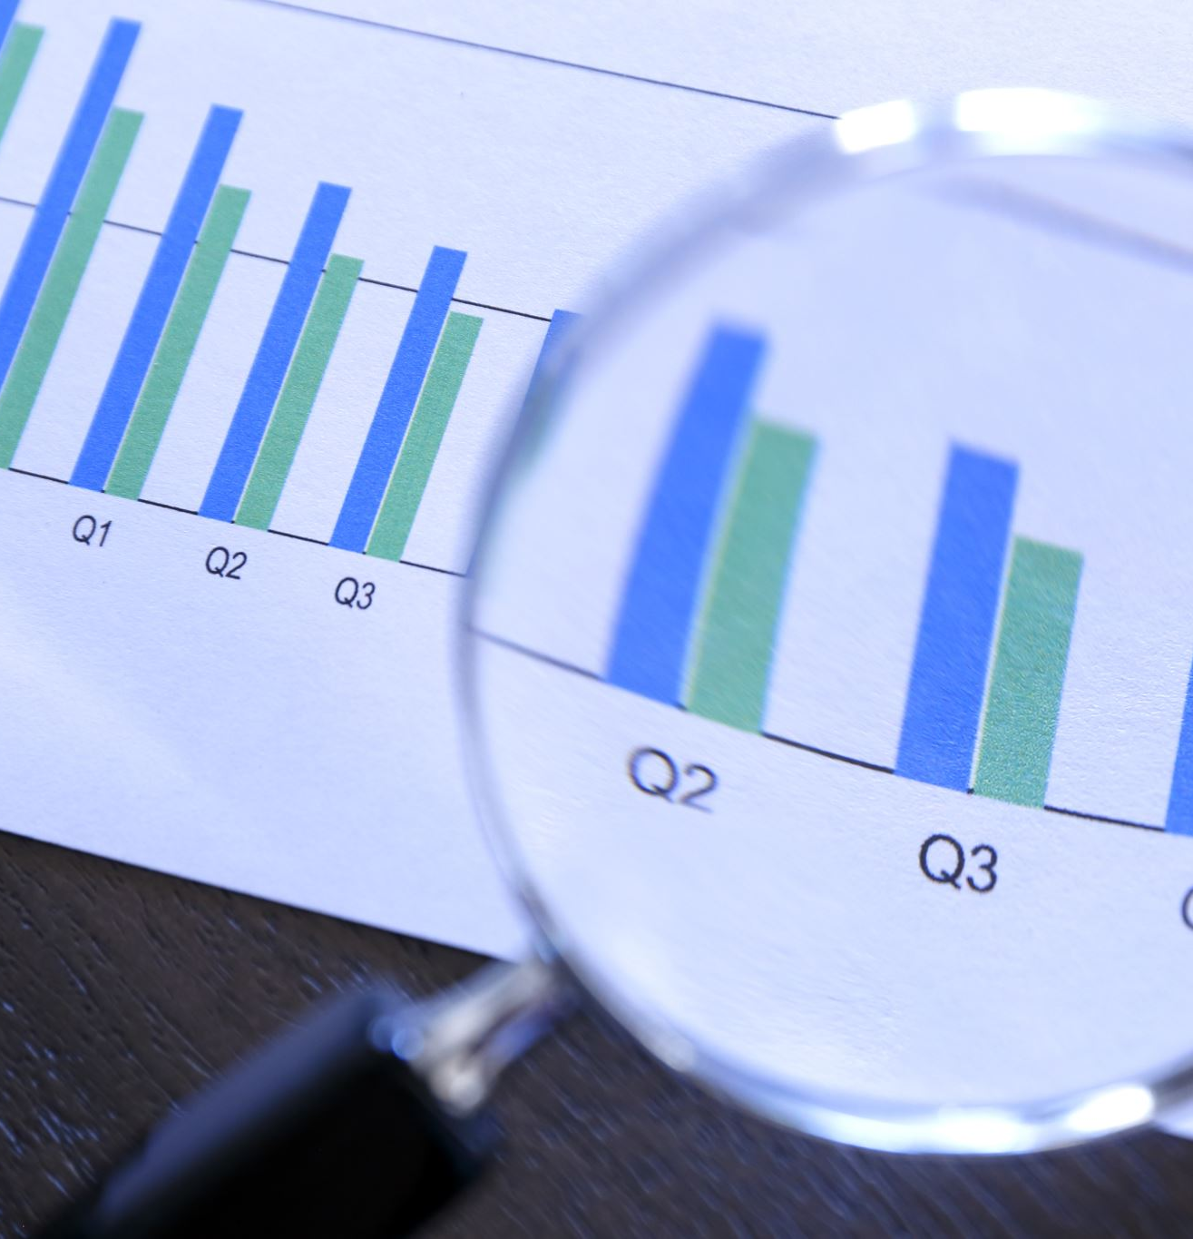
5. Model Evaluation and Monitoring in Modern Data Science
Objective: Evaluate the performance and validity of the developed models.
Importance: Assessment ensures that the models are accurate, reliable, and generalizable to unseen data, confirming their utility and robustness.
Techniques: Cross-Validation, Performance Metrics (e.g., Accuracy, Precision, Recall), ROC Curve Analysis.

Slide 29
5. Model Evaluation and Monitoring in Modern Data Science - Tools
Model Performance Monitoring: tools like MLflow, TensorBoard, or Neptune.ai to track model performance over time.
Bias and Fairness Detection: use of explainability tools like SHAP and LIME for detecting bias and improving model transparency.
A/B Testing: A/B testing and production testing methodologies for machine learning models in production.

Slide 30
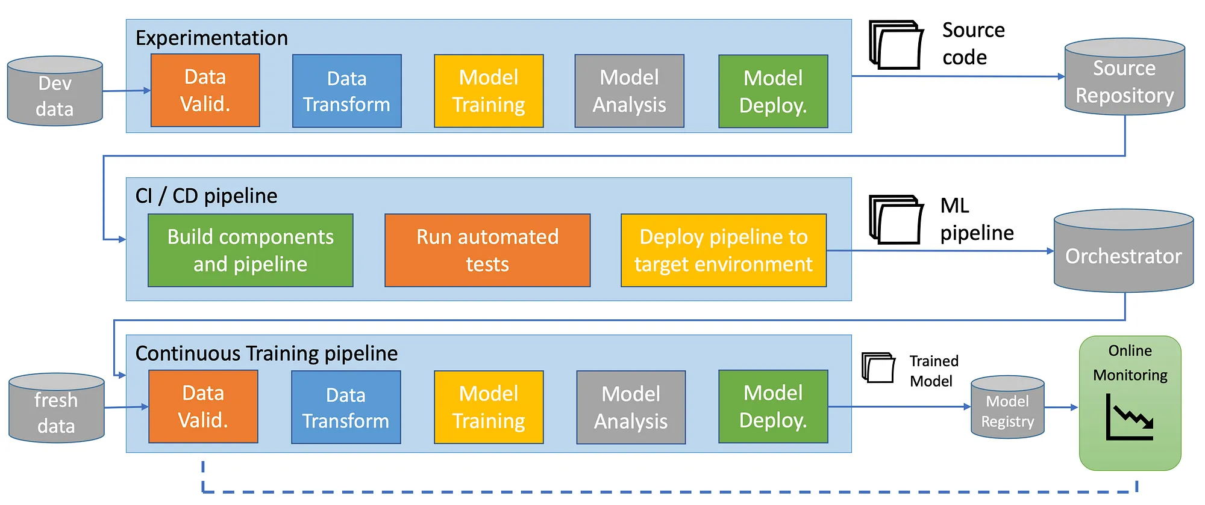
The Evolving Role of SEMMA in Modern Data Mining
Structured Approach: SEMMA provides a systematic and organized framework for conducting data mining projects, ensuring that each step is thoroughly executed.
Efficiency: By breaking down the data mining process into distinct steps, SEMMA allows for efficient management and execution of tasks, facilitating the handling of large and complex datasets.
Insight Generation: SEMMA enables the extraction of meaningful insights and knowledge from data, supporting informed decision-making and strategy formulation.
Optimization: The methodology allows for continuous assessment and refinement of models, optimizing their performance and reliability.
SEMMA is complemented by modern MLOps practices, which ensure continuous integration/continuous deployment (CI/CD) for machine learning models.
the importance of data ethics, privacy, and security, which have become central in modern data mining, especially with regulations like GDPR.
[4]

Slide 31
SEMMA and Future Directions in Data Science
The SEMMA methodology is a comprehensive and structured approach to data mining, guiding analysts through the process of sampling, exploring, modifying, modelling, and assessing data.
It is instrumental in extracting valuable insights from data, aiding organizations in making informed and data-driven decisions.
By adhering to the SEMMA methodology, analysts can ensure the reliability, accuracy, and relevance of their data mining results.
the rising importance of AutoML platforms that allow for more efficient model building.
data mining is moving towards edge devices and IoT, allowing real-time analytics at the data source.
ethical considerations in AI and machine learning, such as fairness and accountability, are shaping the future of data mining

Slide 32
References:
[1] https://www.geeksforgeeks.org/map-reduce-in-hadoop/
[2] https://medium.com/techmonks/apache-kafka-terminology-29ca3b27c111
[3] https://medium.com/@DataEngineeer/apache-flink-for-real-time-stream-processing-e83335a70cfe
[4] https://towardsdatascience.com/mlops-practices-for-data-scientists-dbb01be45dd8

